Slide 1

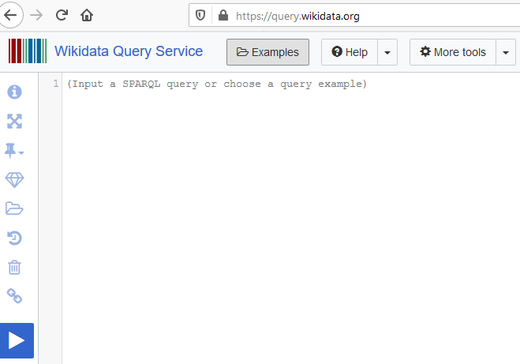
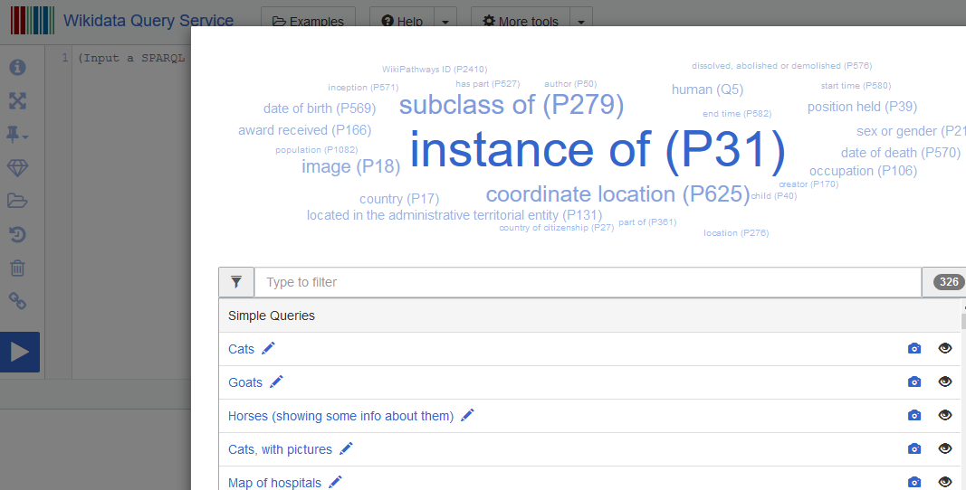
Querying from wikidata using SPARQL
Step No. 1
Step 2. Observe the page
Step 3. As a beginner, I click on examples
Click on Query Service
We have different options here.
There are several options to choose from. After learning from the various examples.

Slide 2
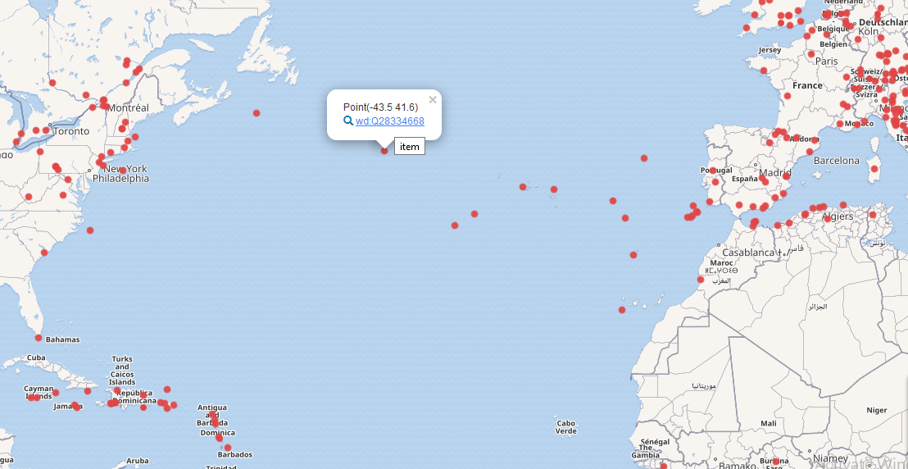
Query Result from (S-Sparql, P-Protocol,A-And,R-RDF,Q-Query,L-Language
#Map of places which got hit my natural disaster
#added 2017-08
#defaultView:Map
SELECT
* WHERE {
?item wdt:P31/wdt:P279* wd:Q8065;
wdt:P625 ?geo .
}

Slide 3
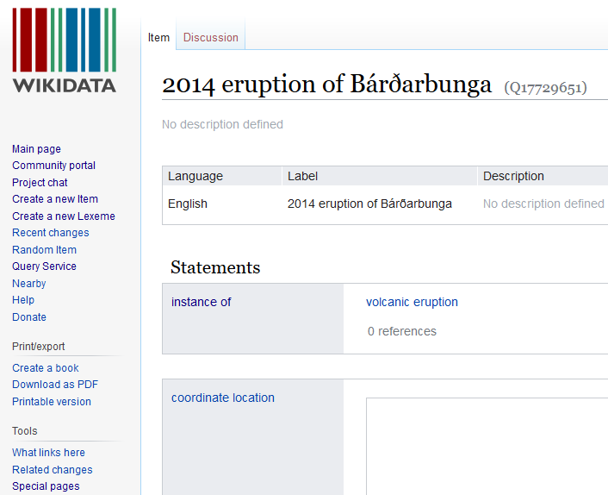
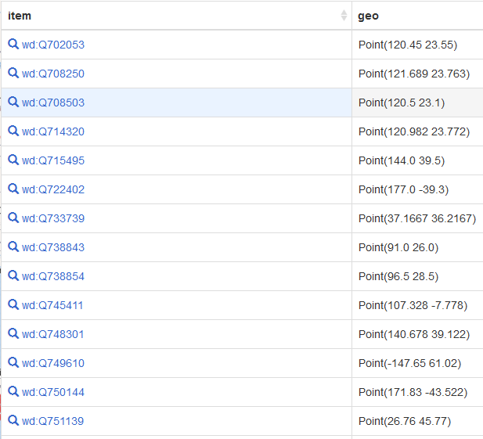
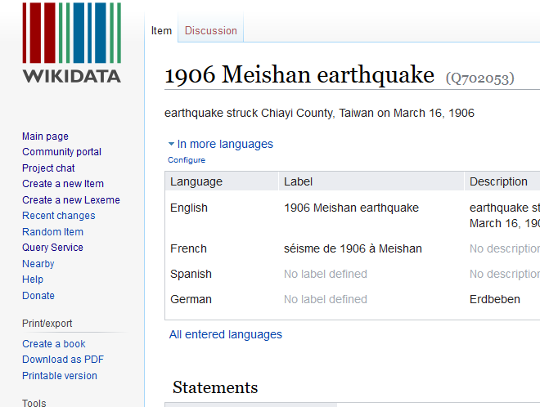
Query Result contd..
Details gotten from map
The result we get by choosing table option
Choosing the first item from table

Slide 4
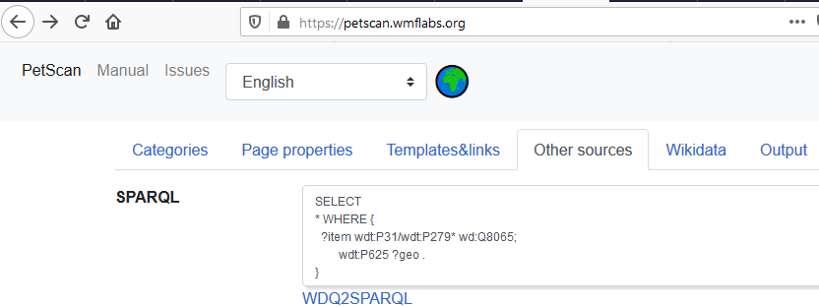
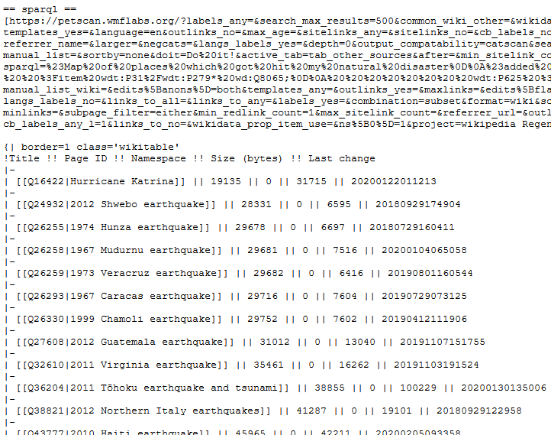
Moving towards the final step
Visit wikipedia.org
Create a profile
Edit your profile’s sandbox
Paste that ugly looking text
https://en.wikipedia.org/wiki/User:Bubaimaulik/sandbox
PETSCAN
TEXT

Slide 5
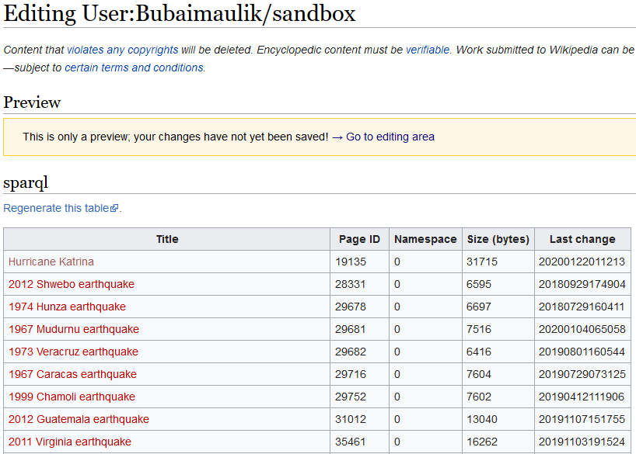

Slide 6
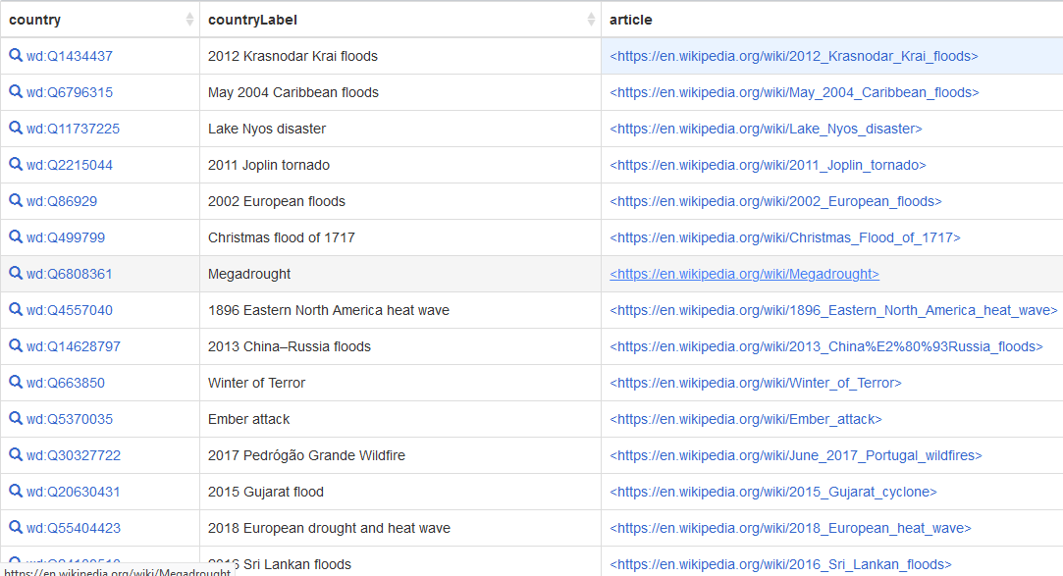
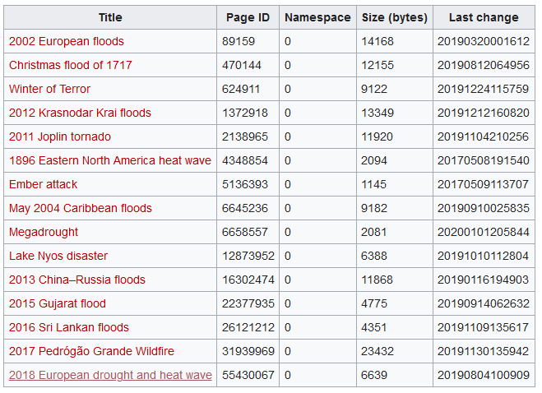
Querying data from Wikipedia.org
SELECT ?country ?countryLabel ?article WHERE {
?country wdt:P31 wd:Q8065.
?article schema:about ?country .
?article schema:isPartOf <https://en.wikipedia.org/>.
SERVICE wikibase:label {
bd:serviceParam wikibase:language "en"
}
}

Slide 7
Querying Data from Wikipedia.org, for just cyclone
SELECT ?country ?countryLabel ?article WHERE {
?country wdt:P31 wd:Q79602.
?article schema:about ?country .
?article schema:isPartOf <https://en.wikipedia.org/>.
SERVICE wikibase:label {
bd:serviceParam wikibase:language "en"
}
}
We have 457 results
When we attempted to query from Wikipedia.org, in regards to natural disaster then just 15 results showed up.
We found 1851 results when we tried to query natural disaster from wikidata.org

